Slide 1


Slide 2

2019 Match Statistics
Match Day 2019

Slide 3
2019 WSU Match Statistics
Number of Match Participants
272
Number of Match Participants includes NRMP, San Fran, Urology, Military, and CaRMS
Total Match Success Rate
98.16%

Slide 4
2019 National NRMP Statistics
National Match Success Rate
93.9%
U.S. Allopathic Medical Students who matched into PGY1
National Unmatched Rate
6.1%
U.S. Allopathic Medical Students who matched into PGY1
National Couples Rate
95%
WSU SOM couples match rate 100%, 7 out of 7

Slide 5
2019 WSU SOAP Placements
Supplemental Offer And Assistance Program
Percent of class placed through SOAP
4.39%
Percent of class remaining unmatched after SOAP
1.84%

Slide 6
2019 WSU Match Statistics
50.3%
Students matched into
Michigan Programs
51.8% in 2018
30.1%
Students matched into
Primary Care
41.1% in 2018
Primary Care includes: FM, IM, IM/EM, Peds, Med/Peds, Ped/Genetics, Peds/Psych/Child Psych, Med/Psych

Slide 7
2019 National Match Statistics
32,194
PGY 1 Positions offered
in the Match
30,232 in 2018
2,756
PGY 2 Positions offered
in the Match
2,678 in 2018

Slide 8
2019 National Match Statistics
19,417
U.S. seniors participated
in the Match
19,312 in 2018
38,376
applicants applied for
35,185
residency positions

Slide 9
2019 National Match Statistics
55.8%
Positions filled by U.S. seniors
58.7% in 2018

Slide 10
2019 National Match Statistics
76.9%
U.S. seniors who matched got one of their top three choices
77.3% in 2018

Slide 11
2019 National Match Statistics by Rank
U.S. Senior Matched Applicants
First Rank: 50.0%
Second Rank: 16.2%
Third Rank: 10.7%
Fourth Rank: 6.9%
> Fourth Rank: 16.2%
Notes:
Need to update to 2019 numbers

Slide 12


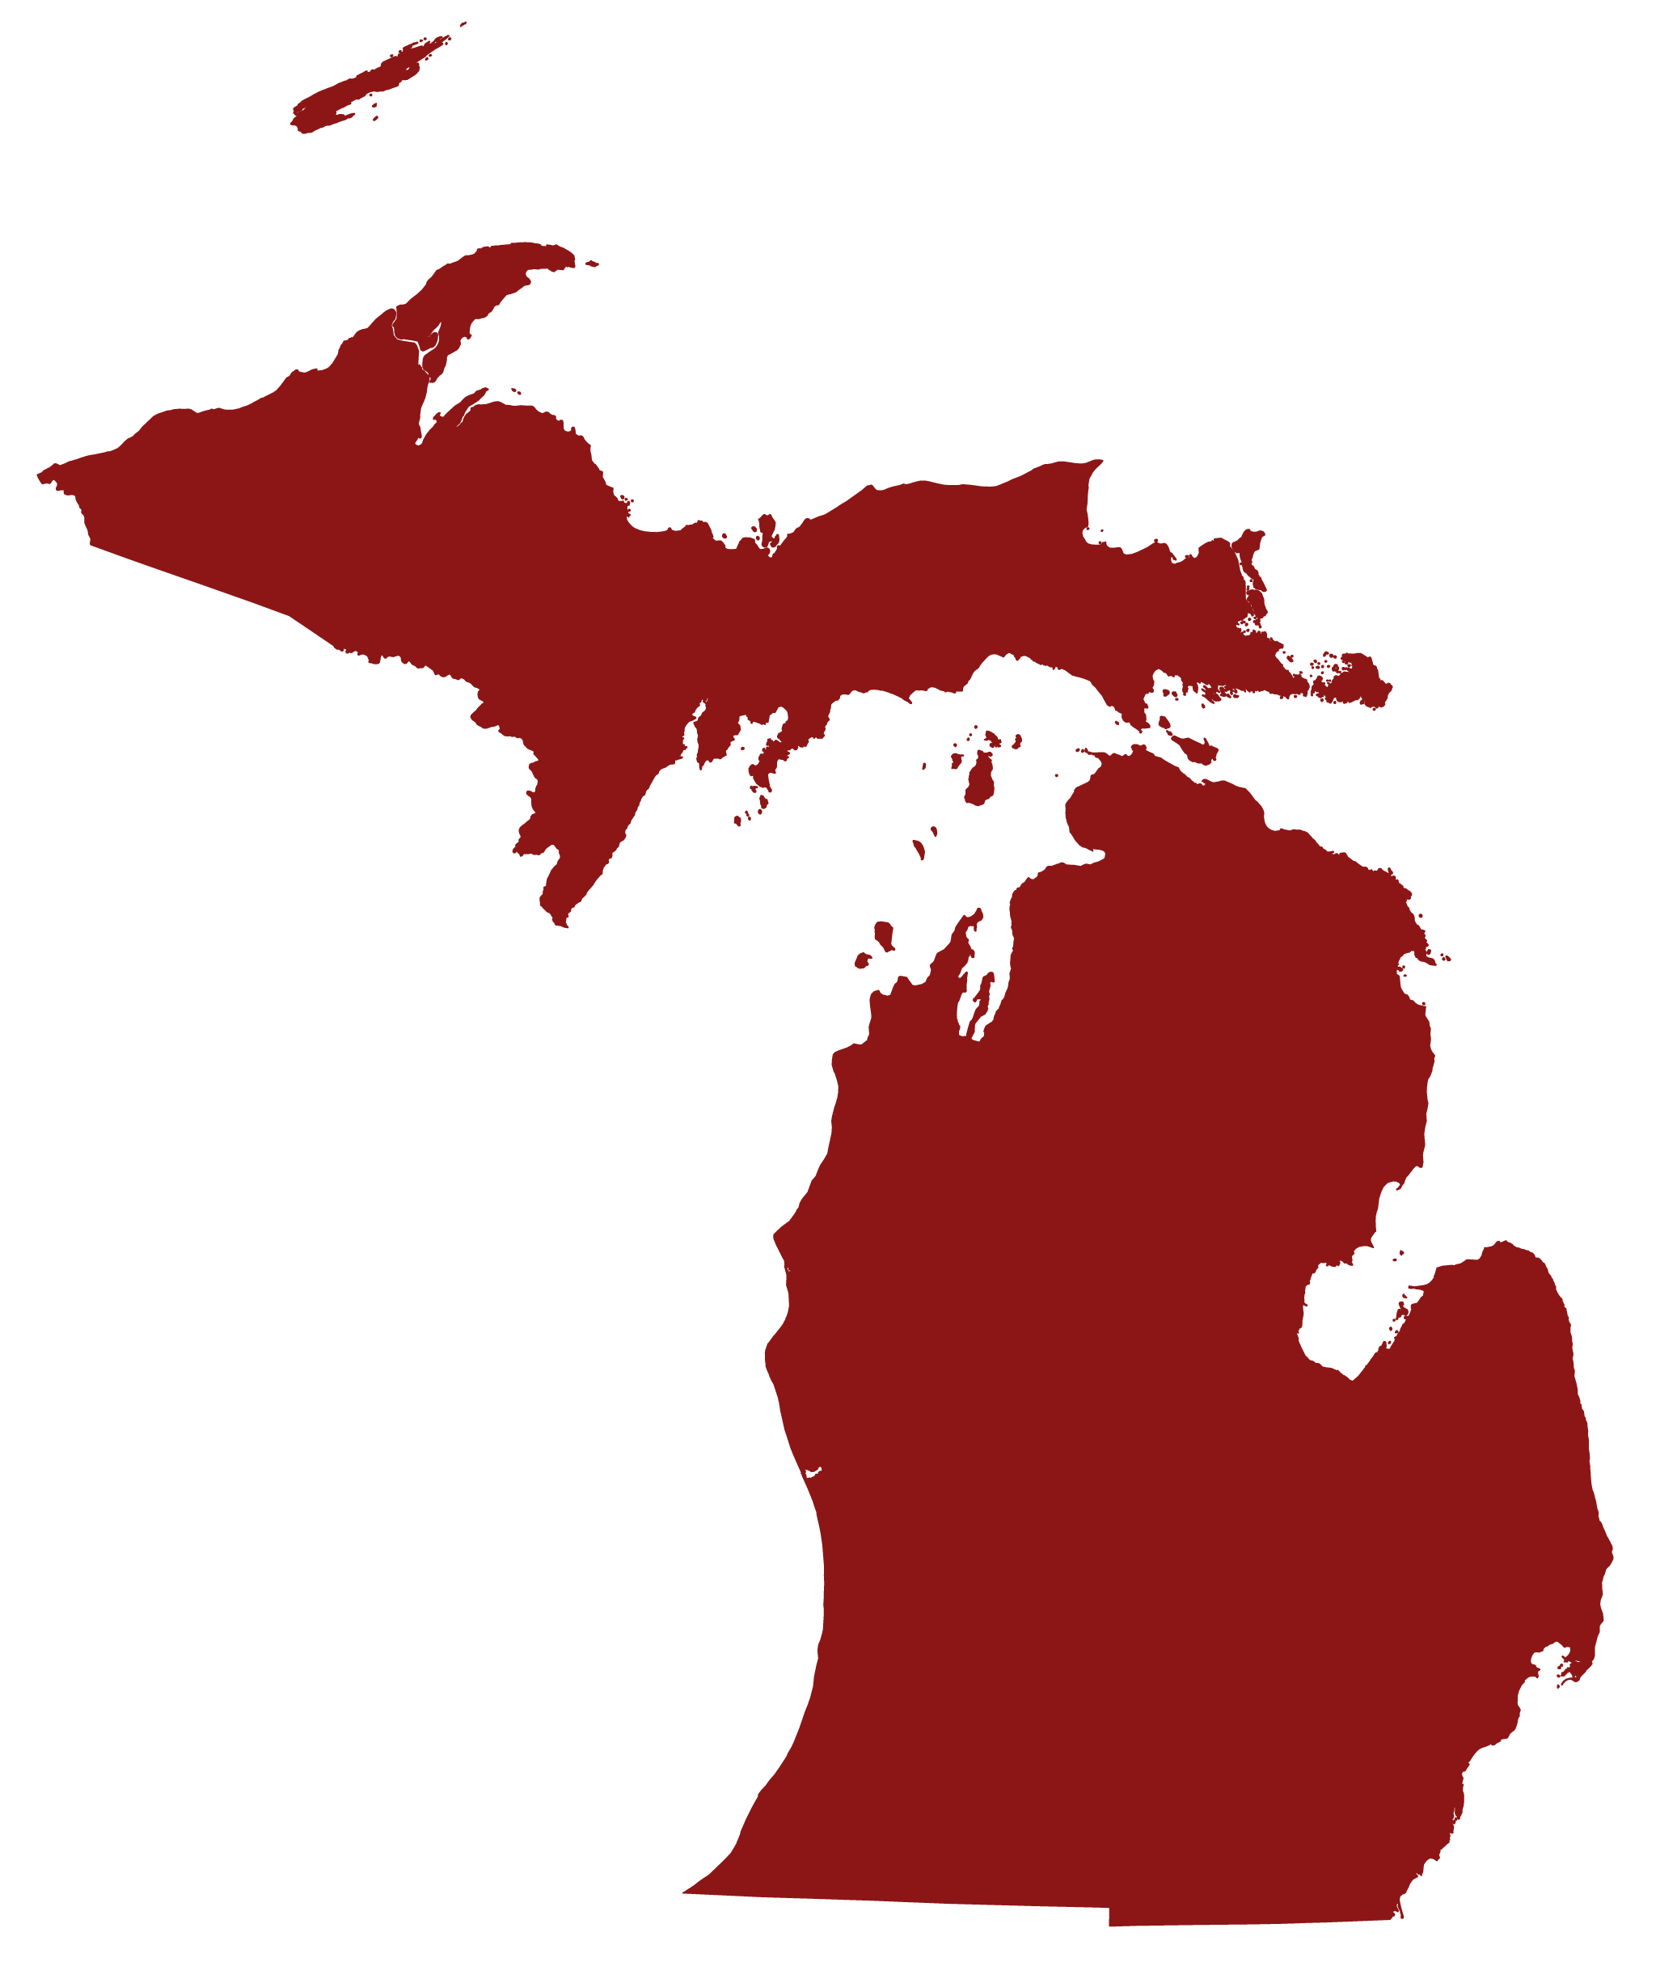
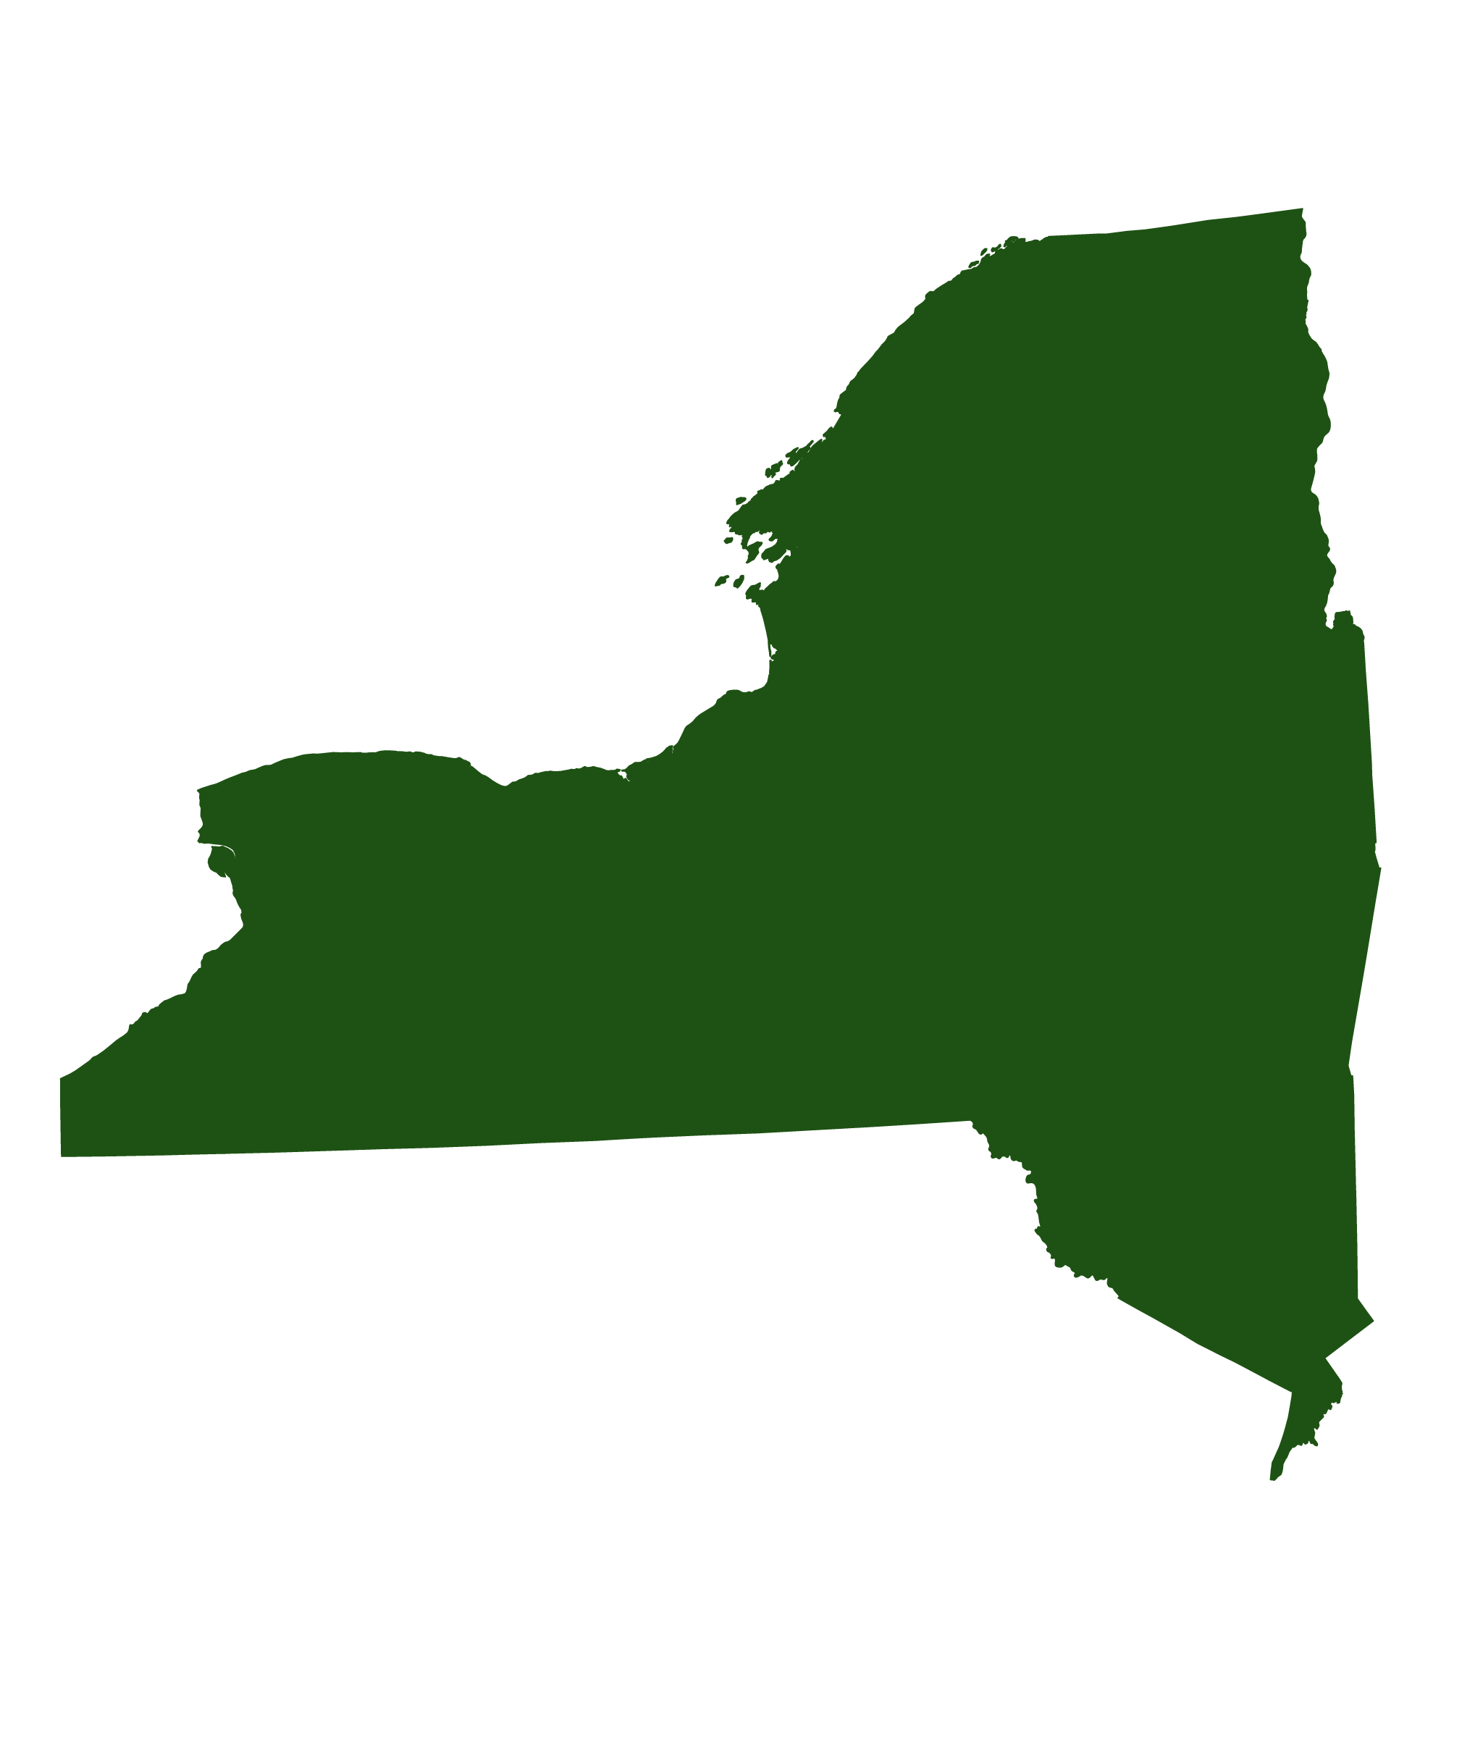

2019 WSU Numbers by State
Top 5 States
29
Illinois: 17
Ohio:12
States Represented
1 Province: Ontario
Michigan: 152
California: 17
New York: 11
Notes:
eed to update with 2019 numbers and info.

Slide 13

2019 WSU Numbers by Specialty
Top 3 Specialties
26
Internal
Medicine
Family
Medicine
Emergency
Medicine
Specialties Represented
2010-present: Same
% of class in top three - 2019: 34.19%, 2018: 48.16%

Slide 14
2019 Specialty Placements at a Glance
Top Specialties
Internal Medicine: 41
2018: 55
Psychiatry: 18
2018: 7
Ophthalmology: 12
2018: 10
Emergency Medicine: 27
2018: 42
General Surgery: 17
2018: 14
Pediatrics: 11
2018: 19
Family Medicine: 25
2018: 47
Anesthesia: 15
2018: 13
Orthopaedic Surgery: 7
2018: 11
Diagnostic Radiology: 18
2018: 8
Obstetrics/Gynecology: 15
2018: 8
Neurology: 5
2018: 9

Slide 15
WSU Match Specialties continued
Internal Medicine/Pediatrics: 5
2018: 1
Dermatology: 2
2018: 5
Urology: 4
2018: 4
Physical Medicine and Rehabilitation: 1
2018: 4
Oral Maxillofacial Surgery: 4
2018: 4
Plastic Surgery: 1
2018: 1
Ear/Nose/Throat: 3
2018: 3
Peds/Psych/Child Psych: 0
2018: 1
Pathology: 3
2018: 7
Child Neurology: 0
2018: 2
Radiation Oncology: 3
2018: 1

Slide 16
Added Match Specialties 2019
Neurological Surgery: 4
Interventional Radiology: 4
Vascular Surgery: 3
Thoracic Surgery: 1
Internal Medicine/Emergency Medicine: 1

Slide 17





2019 WSU Michigan Based Program Placements
20
Detroit Medical Center: 36
Henry Ford
Health System: 19
Beaumont
Health System: 18
Michigan Based Health Systems/Centers Represented
University of Michigan: 16
Ascension
St. John: 14

Slide 18
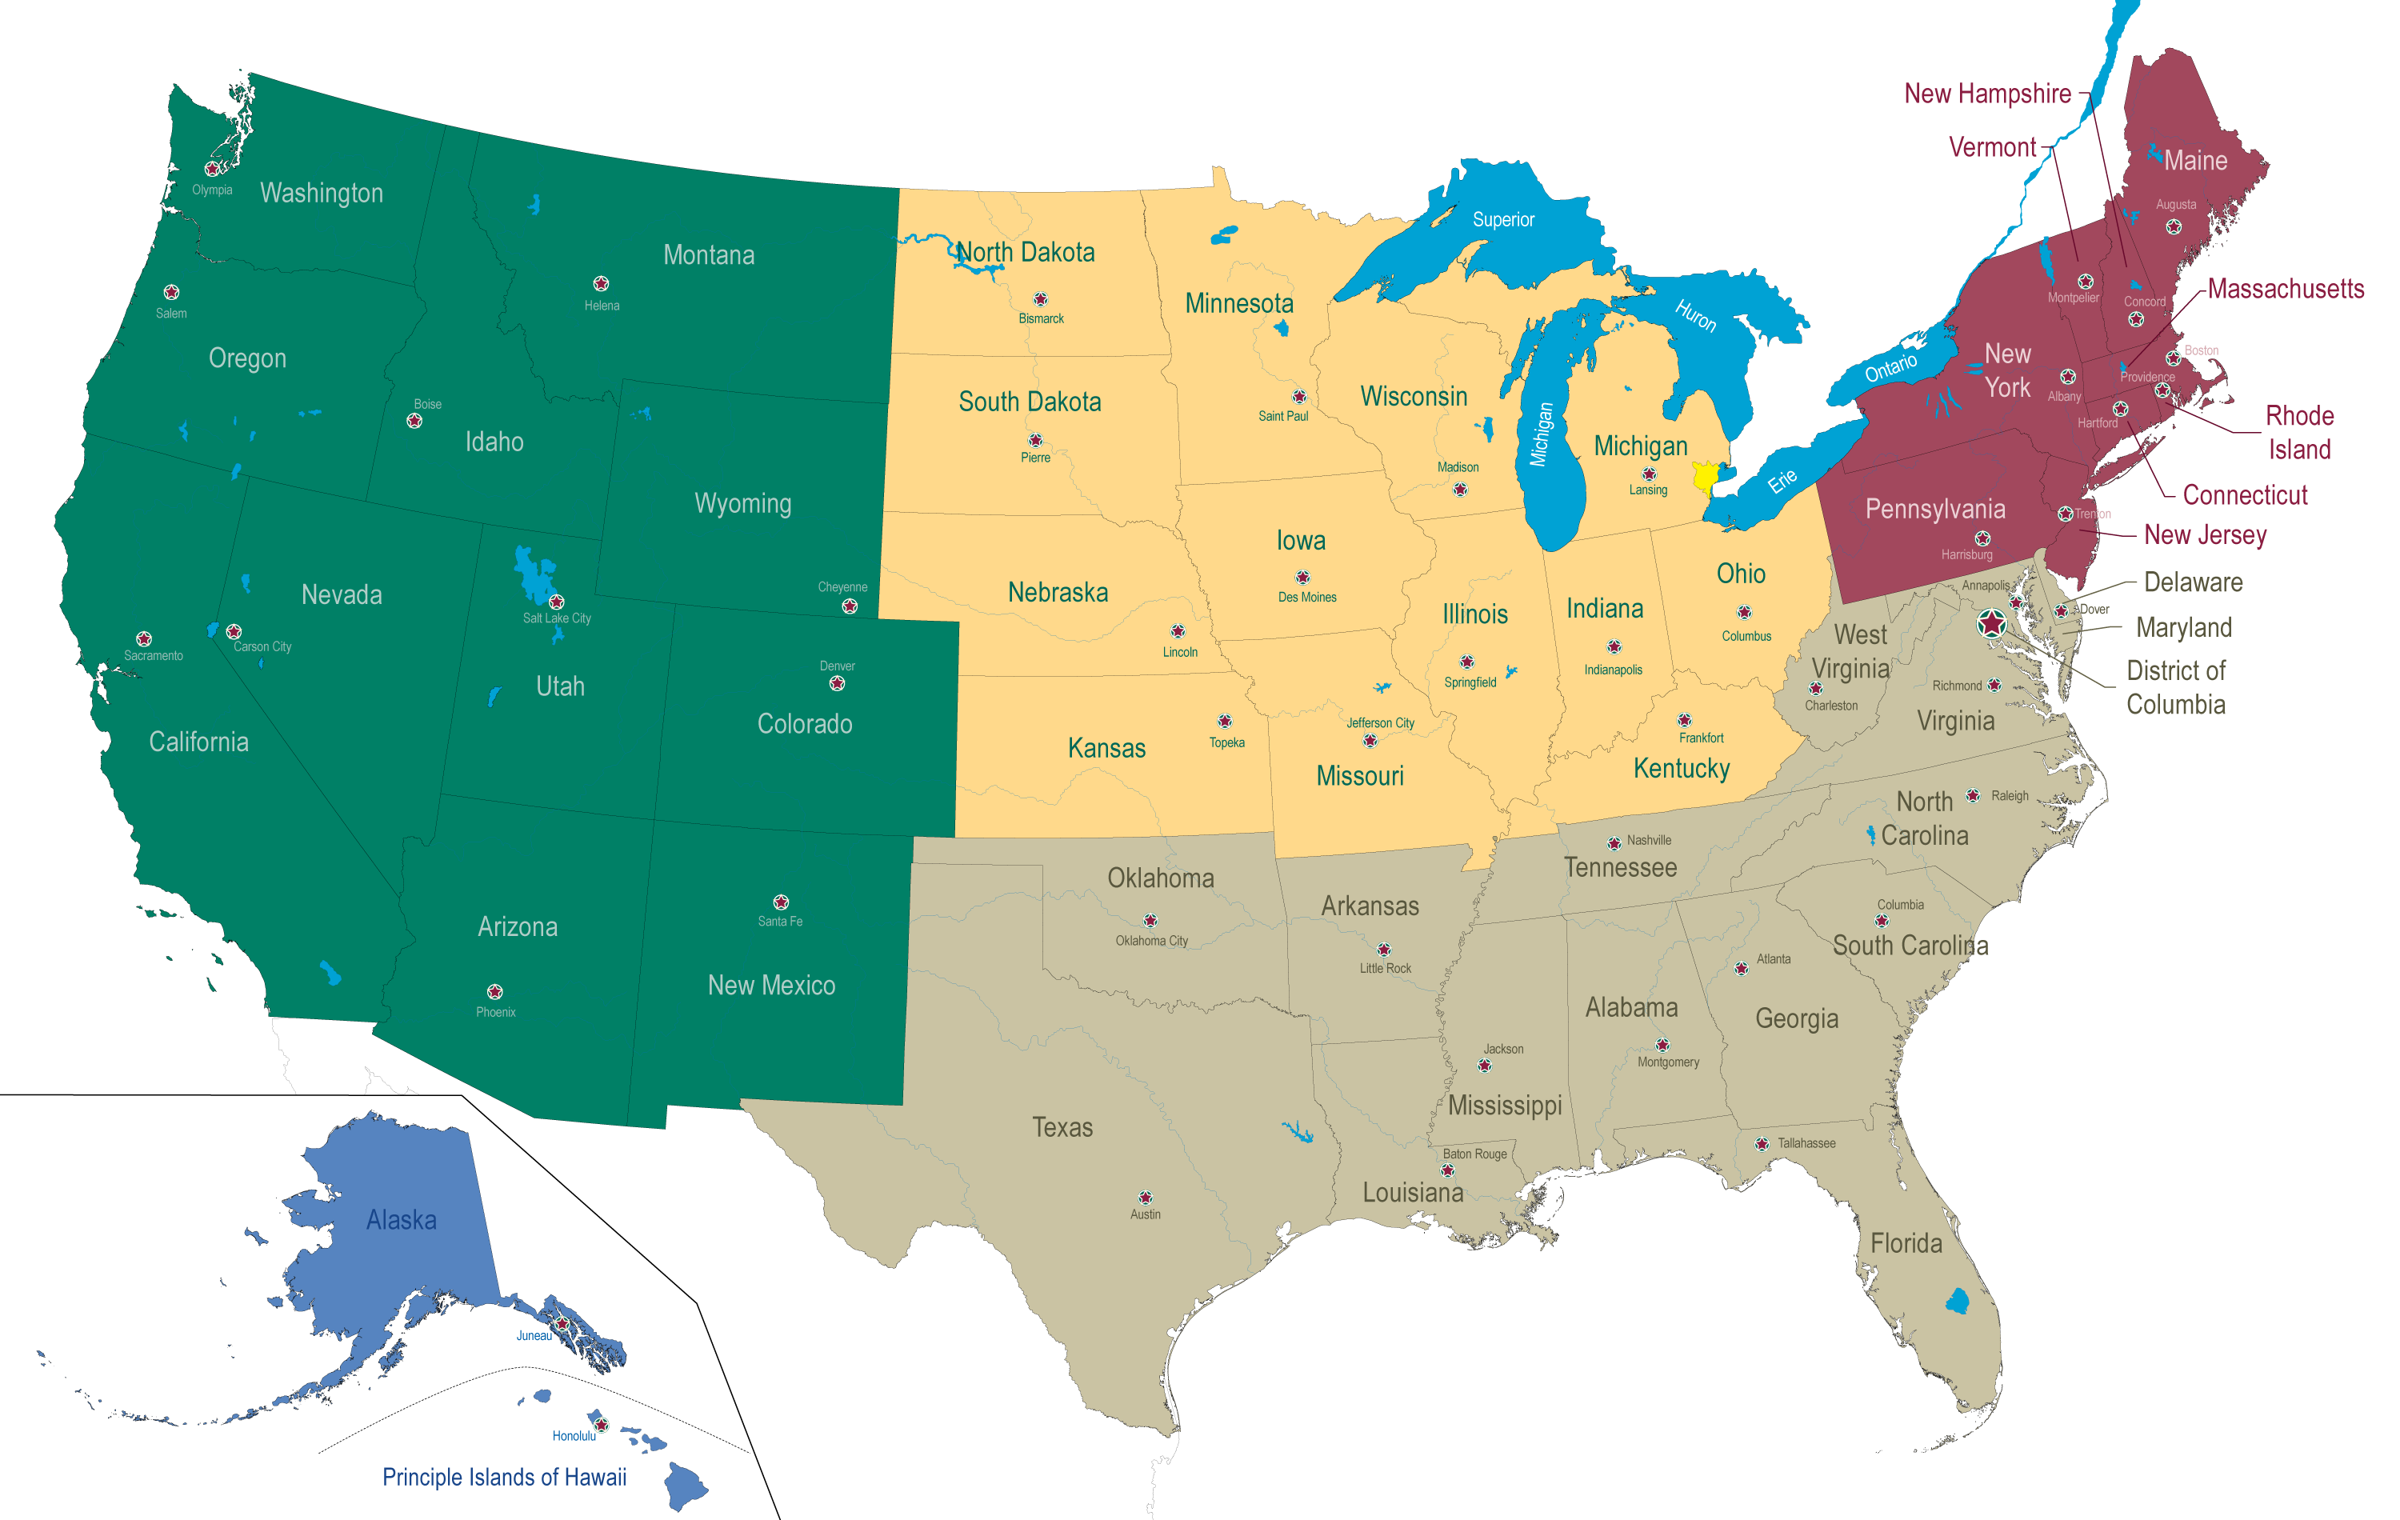
Ontario
Congratulations!

Slide 19
2019 WSU Match Placement by Institution
Advocate Health Care
Advocate Health Care/ACMC
Albert Einstein Medical Center
Arrowhead Regional Medical Center
Ascension Providence/MSUCHM
Ascension St. John Hospital
Authority Health GME
Aventura Hospital
Barnes - Jewish Hospital
Baystate Medical Center
Beaumont Health/Royal Oak
Beaumont Health/Wayne
Beaumont Health/Dearborn
Beaumont Health/Dearborn & Taylor
Beaumont Health/Grosse Pointe
Beaumont Health/Royal Oak
Beaumont Health/Trenton
Beaumont Health/Wayne
Boston University Medical Center
Brigham & Womens Hospital
Bryn Mawr Hospital
Carolinas Medical Center
Carolinas Medical Center/Elizabeth/Traditional
Case Western Reserve University
Case Western Reserve University/Cleveland Medical Center
Case Western/University Hospitals Cleveland Medical Ctr
Central Michigan University COM
Children's Hospital - NEOMED
Children's Hospital of Michigan
Childrens Mercy Hospital
Christiana Care
Cleveland Clinic Foundation
Detroit Medical Center/WSU
Detroit Medical Center/WSU/Harper/VA
Detroit Medical Center/WSU/Sinai-Grace
Duke University Medical Center

Slide 20
2019 WSU Match Placement by Institution
Eastern Virginia MS
Emory University Hospital
Emory University School of Medicine
Greenville Health System/Univ. of South Carolina
Halifax Medical Center
Harbor- UCLA Medical Center
Hemet Valley Medical Center
Hennepin County Medical Center
Henry Ford Hospital
Henry Ford Macomb Hospital
Hospital of the University of Pennsylvania
Hurley Medical Center
Icahn School of Medicine St. Lukes - Roosevelt
Indiana University School of Medicine
INOVA Fairfax Hospital
Intermountain Medical Center
Jersey City Medical Center
Johns Hopkins Hospital
Kaiser Permanente - Oakland
Kaiser Permanente - San Jose
Kaiser Permanente/Oakland/East Bay
Kresge Eye Institute /Wayne State University
Lakeland Health
Loma Linda University
Loyola University Medical Center
MacNeal Hospital
MacNeil Hospital
Mayo Clinic School of Graduate Medical Education
McLaren Health Care Corp
McLaren Health Care Corp/Flint
McMaster University/Hamilton
Medical College Wisconsin Affiliated Hospitals/Milwaukee
Medical University of South Carolina
MedStar Georgetown University Hospital
Mercy Catholic Medical Center
Mercy Health Grand Rapids

Slide 21
2019 WSU Match Placement by Institution
Michigan State University CHM/East Lansing
Mount Auburn Hospital
Mount Sinai Medical Center
Nationwide Children's Hospital
New York Eye & Ear Infirmary of Mount Sinai
NYU School of Medicine
Orlando Health
Penn State Hershey Medical Center
Phoenix Children's Hospital
Pine Rest Christian Mental Health Services
Presence St. Joseph Hospital
Providence Sacred Heart Medical Center
Queens University/Kingston
Rhode Island Hospital/Brown University
Rush University Medical Center
San Antonio Military Medical Center
Santa Clara Valley Medical Center
Spectrum Health/Michigan State University
St. John Hospital
St. John Hospital of Eureka
St. Joseph Mercy - Ann Arbor
St. Louis Children's Hospital
St. Louis University School of Medicine
St. Mary Mercy Hospital
SUNY Upstate Medical University
Sutter Medical Center of Santa Rosa
Temple University Hospital
TIGMER/San Antonio
UC Irvine Medical Center
UC San Francisco
UC San Francisco/Fresno
University of Arizona College of Medicine at Tucson
University of California Irvine Medical Center
University of Chicago Medical Center
University of Chicago Medical Center/North Shore
University of Cincinnati Medical Center

Slide 22
2019 WSU Match Placement by Institution
University of Colorado School of Medicine - Denver
University of Illinois College of Medicine
University of Kentucky Medical Center
University of Louisville School of Medicine
University of Michigan Hospitals - Ann Arbor
University of Michigan Hospitals - Ann Arbor/Chelsea
University of Minnesota - Minneapolis
University of Minnesota Medical School
University of Missouri - Kansas City
University of Tennessee COM - Memphis
University of Texas Medical Branch-Galveston
University of Texas Southwestern - Dallas
University of Texas Southwestern Medical School - Dallas
University of Toledo
University of Toronto/Barrie-Newmarket
University of Utah Affiliated Hospitals
University of Virginia
University of Washington Affiliated Hospitals
University of Wisconsin Hospital and Clinics
University of Toronto
University of Wisconsin Hospital and Clinics
UPMC Medical Education
UPMC St. Margaret
Vanderbilt University Medical Center
Wake Forest Baptist Medical Center
Wayne State University
Wayne State University School of Medicine
Western Michigan University Stryker School of Medicine
Yale-New Haven Hospital
Zucker School of Medicine -Northwell Cohen Childrens
Zucker School of Medicine -Northwell Staten Island

